Slide 1
Bio& 242 A&P
Unit 4 / Lecture 1B

Slide 2
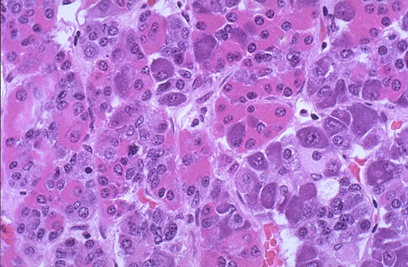
Hormones Released from the Anterior Pituitary or Adenohypophysis
Somatotrophs
Human Growth Hormone (hGH)
Hypothalamic control
hGH releasing hormone
hGH inhibiting hormone
Target Tissues:
General body cells, particularly bone, muscle, cartilage, and the liver.

Slide 3
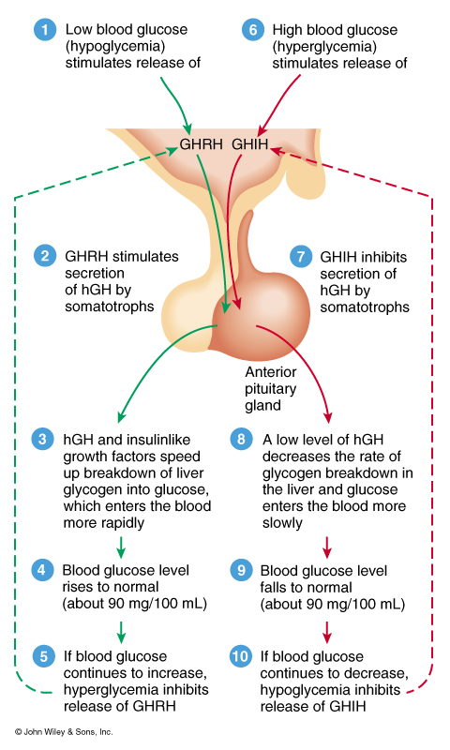
Hormones Released from the Anterior Pituitary or Adenohypophysis
Hormone affects:
promotes the synthesis of insulin-like growth factors
Controls normal growth patterns by increasing protein synthesis, lipolysis, ATP production, and carbohydrate metabolism
In adults, it help maintain muscle and bone mass and promote healing and tissue repair

Slide 4
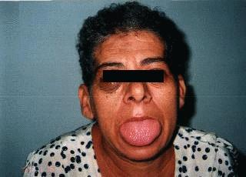
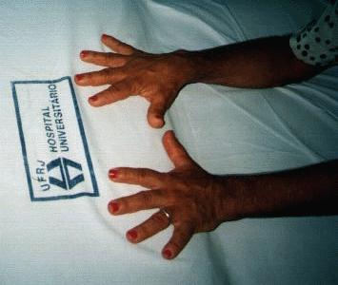
Hormones Released from the Anterior Pituitary or Adenohypophysis
Hypo-secretion:
  During childhood causes pituitary Dwarfism
Hyper-secretion:
During childhood causes
Gigantism
During Adulthood causes
Acromegaly: Enlargement of the small bones of the hand and feet
Enlargement of the cranium, nose, and lower jaw
Tongue, liver, and kidneys become enlarged

Slide 5
Pituitary Dwarfism
Dwarfism is a condition in which the growth of the individual is very slow or delayed. Decreased bodily growth is due to hyposecretion of hGH. The end result is a proportionate little person, because height as well as growth of other structures are also decreased.
Can be caused by gene mutations:
Appears to be disruption on different areas of chromosome 3 and 7. Some studies have isolated defects for the production of pituitary hormones to the short arm (the "p" end) of chromosome 3 at a specific location of 3p11. Other studies have found changes on the short arm of chromosome 7.
Or tumors:
Most commonly craniopharyngioma (a tumor near the pituitary gland), children and adolescents.
Symptoms: headaches, vomiting, problems with vision (double vision), excessive drinking behaviors (polydipsia) and sleep disturbances may be common.
,

Slide 6
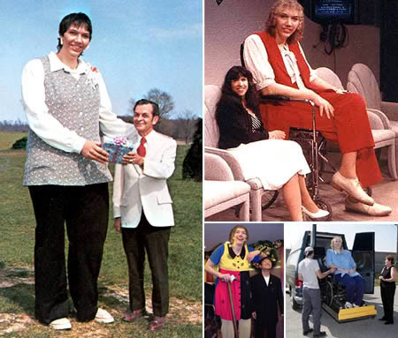
Pituitary Gigantism
Hyper secretion of human growth hormone (hGH) before the end of adolescence. People with pituitary gigantism can truly be giants. They can sometimes end up over 7 or 8 feet in height.
Typically caused by an adenoma (tumor) of the pituitary.

Slide 7
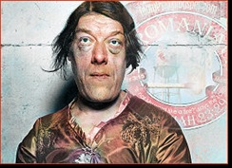
Acromegaly
Results from hypersecretion of growth hormone (GH). Usually the excess GH comes from benign, or noncancerous, adenoma (tumor) of the pituitary.
Acromegaly is most often diagnosed in middle-aged adults.
If not treated, acromegaly can result in serious illness and premature death.
Because of its slow and often “sneaky” onset, it often is not diagnosed early or correctly.

Slide 8
Other symptoms of acromegaly
joint aches
thick, coarse, oily skin
skin tags
enlarged lips, nose, and tongue
deepening of the voice due to enlarged sinuses and vocal cords
sleep apnea—breaks in breathing during sleep due to obstruction of the airway
excessive sweating and skin odor
fatigue and weakness
headaches
impaired vision
abnormalities of the menstrual cycle and sometimes breast discharge in women
erectile dysfunction in men
decreased libido

Slide 9
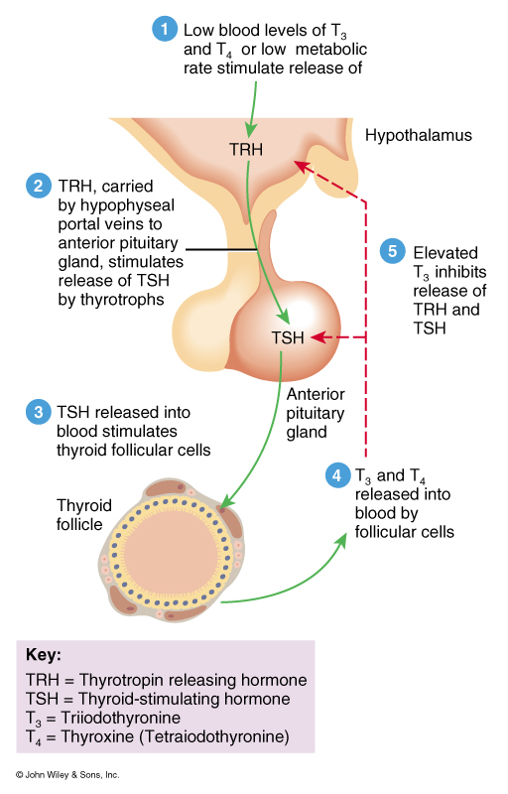
Hormones Released from the Anterior Pituitary or Adenohypophysis
Thyrotrophs:
Thyroid Stimulating Hormone (TSH)
Hypothalamic Control
Thyrotropin Releasing Hormone (TRH)
Target Tissue
Follicular cells of the Thyroid gland
Hormone affects:
Controls the production of T3 and T4

Slide 10
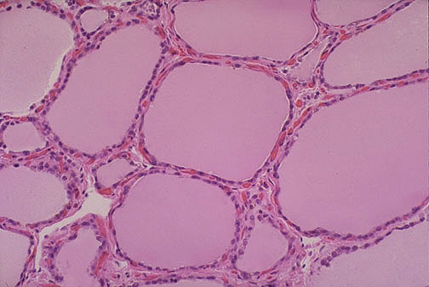
Thyroid Gland
Follicular cells:
T3 and T4
Target Tissue;
Almost all body tissues
Hormone effects:
Increases body metabolism
Increases gluconeogenesis
Increases glycolysis
Increases lipolysis
Increased basal metabolic rate (BMR)
Increases heart rate and force of contraction

Slide 11
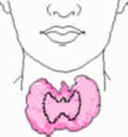
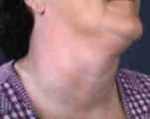
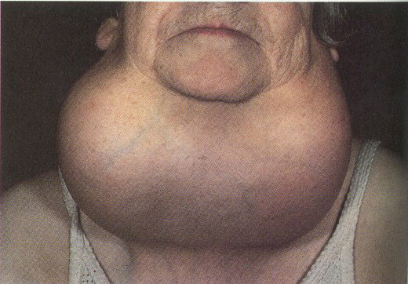
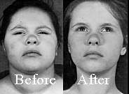
Thyroid Gland
Hypothyroidism:
endemic goiter: (due to I2 deficiency)
Myxedema: bagginess under the eyes and swelling of the face.
Arteriosclerosis: due to increase in blood cholesterol
Cretinism: extreme hypothyroidism during infancy and childhood

Slide 12
Symptoms of Hypothyroidism
Fatigue
Weakness
Weight gain or increased difficulty losing weight
Coarse, dry hair
Dry, rough pale skin
Hair loss
Cold intolerance (you can't tolerate cold temperatures like those around you)
Muscle cramps and frequent muscle aches
Constipation
Depression
Irritability
Memory loss
Abnormal menstrual cycles
Decreased libido

Slide 13
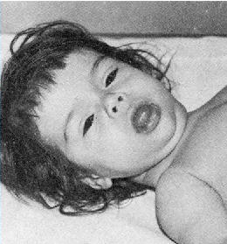
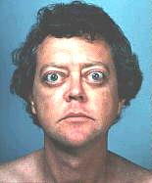
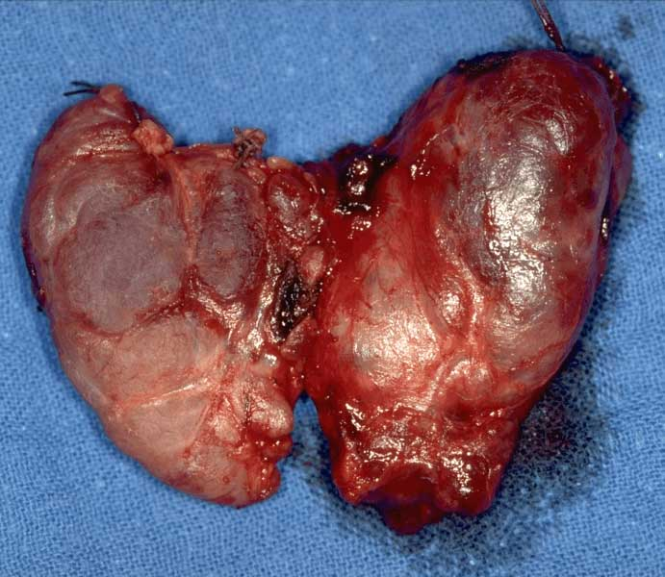
Thyroid Gland
Hypothyroidism:
Cretinism: Physical and mental growth and development is greatly retarded
Hyperthyroidism
Toxic goiter
Graves Disease with exophthalmos
occurs when your immune system mistakenly attacks your thyroid gland and causes it to overproduce the hormone thyroxine.

Slide 14
Symptoms of Graves’ disease
Graves’ disease, also known as toxic diffuse goiter, is the most common cause of hyperthyroidism in the United States
Common symptoms of hyperthyroidism:
nervousness or irritability
fatigue or muscle weakness
heat intolerance
trouble sleeping
hand tremors
rapid and irregular heartbeat
frequent bowel movements or diarrhea
weight loss
goiter

Slide 15
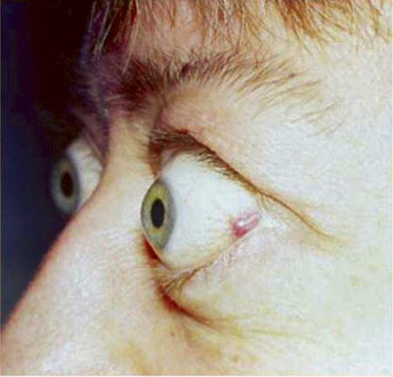
Grave’s ophthalmopathy
Occurs when cells from the immune system attack the muscles and other tissues around the eyes. The result is inflammation and a buildup in tissue and fat behind the eye socket, causing the eyeballs to bulge. In rare cases, inflammation is severe enough to compress the optic nerve that leads to the eye, causing vision loss.
Other symptoms of GO
dry, irritated eyes
puffy eyelids
double vision
light sensitivity
pressure or pain in the eyes
trouble moving the eyes

Slide 16
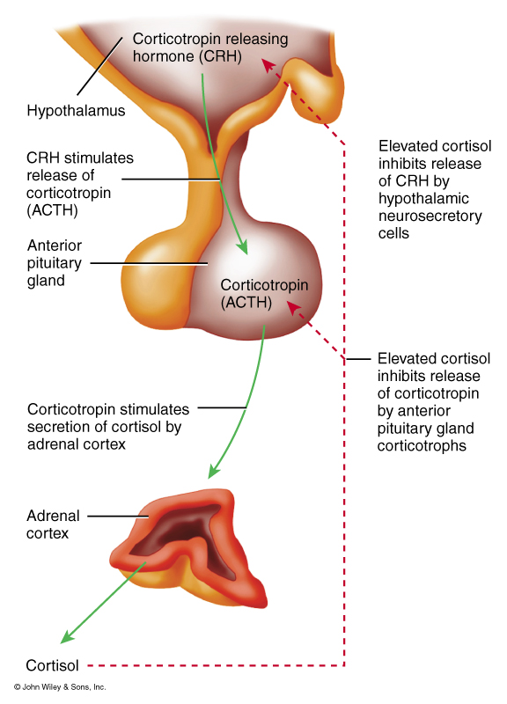
Anterior Pituitary or Adenohypophysis
Corticotrophs
Adrenocorticotropic hormone (ACTH)
Hypothalamic Control
Corticotropic releasing hormone (CRH)
Target Tissue
Adrenal cortex, Zona Fasciculata
Hormone affects:
control production of glucocorticoids such as cortisol

Slide 17
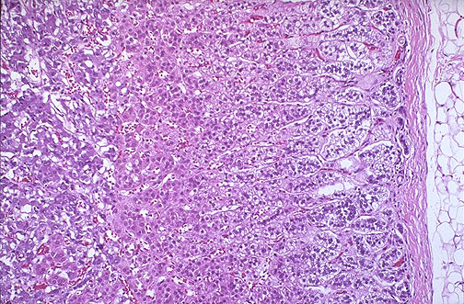
Adrenal Cortex
Zona Fasciculata
Glucocorticoids such as cortisol and cortisone
Hormone control:
ACTH
Target tissue:
Liver and general body cells
Hormone affects:
helps maintain blood pressure and cardiovascular function
helps slow the immune system's inflammatory response
helps balance the effects of insulin in breaking down sugar for energy
helps regulate the metabolism of proteins, carbohydrates, and fats
helps maintain proper arousal and sense of well-being

Slide 18
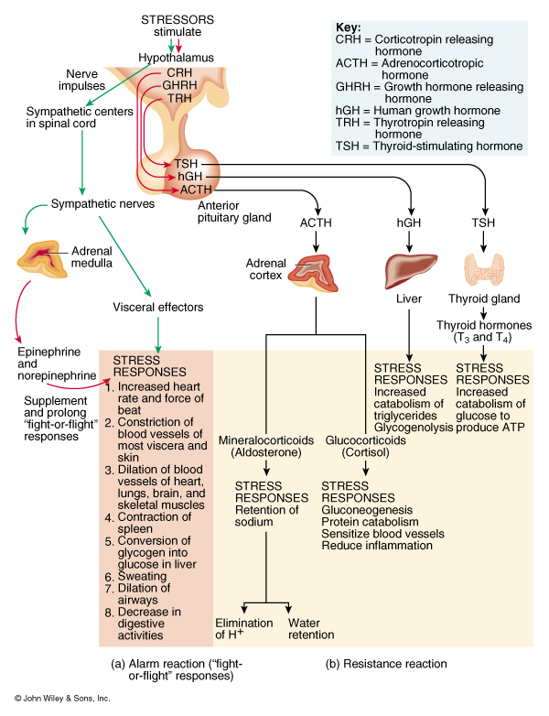
Adrenal Cortex
Hormone affects:
Elevated blood glucose levels
Reduction of protein stores in all body cells except the liver
increased plasma protein levels
promote lipolysis and beta oxidation of fat
Helps body recover from stress
Prevention of inflammation

Slide 19
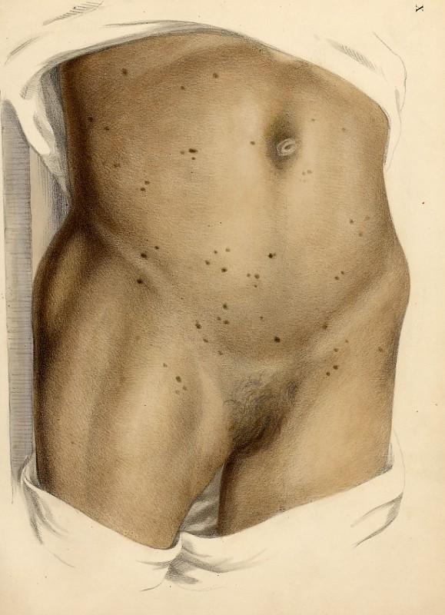
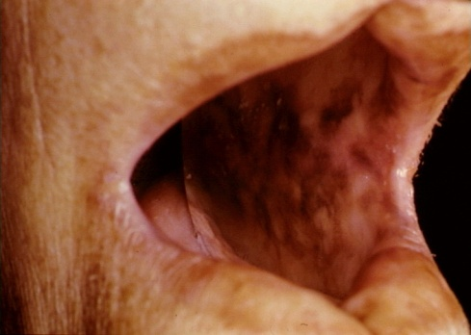
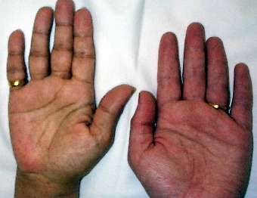
Adrenal Cortex
Hypo-secretion
Addison’s disease –
Failure to produce adequate levels of cortisol
Symptoms
chronic, worsening fatigue , muscle weakness ,
loss of appetite , weight loss , nausea , vomiting ,diarrhea
Other symptoms include
low blood pressure that falls further when standing,
causing dizziness or fainting
hyperpigmentation, or dark tanning;
this darkening of the skin is most visible on scars; skin folds;
pressure points such as the elbows, knees, knuckles, and toes; lips;
and mucous membranes

Slide 20
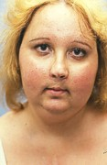
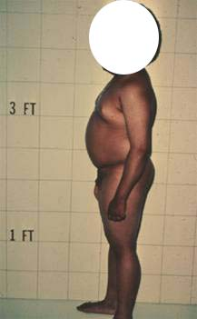
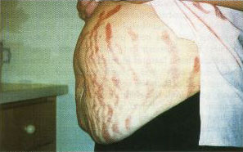
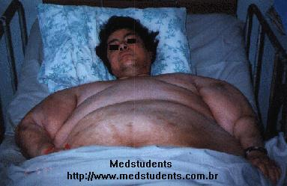
Adrenal Cortex
Hyper-secretion:
Cushing’s Syndrome
Symptoms
Upper body obesity, rounded face, increased fat around the neck, and thinning arms and legs. Children tend to be obese with slowed growth rates.
Skin, becomes fragile and thin. bruises easily and heals poorly. Purplish pink stretch marks may appear on the abdomen, thighs, buttocks, arms and breasts
Women usually have excess hair growth on their faces, necks, chests, abdomens, and thighs

Slide 21
Adrenal Cortex
Zona glomerulosa
Mineralocorticoids such as Aldosterone
Hormonal control
renin-angiotensin pathway
permissive effect of ACTH
Target tissue
Principle cells of the DCT and collecting duct
Hormone affects
increases reabsorption of Na+ and water

Slide 22
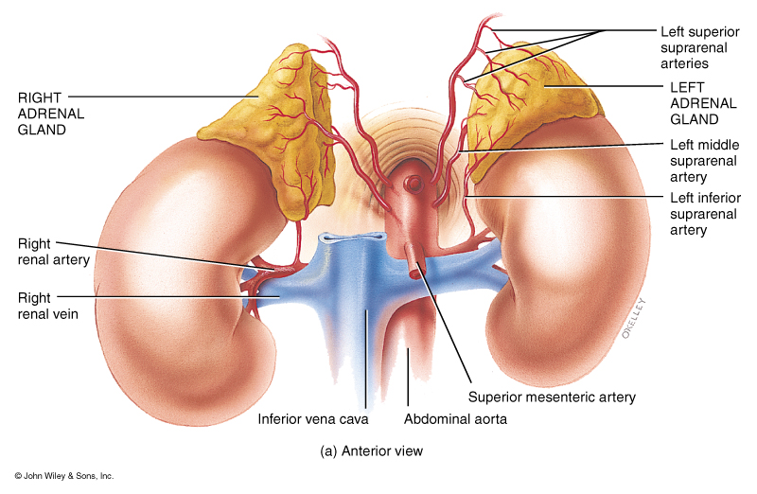
Adrenal Cortex
Hyper-secretion:
Aldosteronism:
Hypokalemia, increase in extracellular fluid and blood volume,and hypertension, may also have period of muscular paralysis
Hypo-secretion:
Mineralocorticoids deficiency, death occurs in four days to two weeks if untreated

Slide 23
Overview of the interactions of hormones in response to stress

Slide 24
Adrenal Cortex
Zona reticularis
Produces small amounts of androgens, mostly dehydroepiandosterone (DHEA), DHEA may be converted into estrogens
Hormone Control:
Believed to be ACTH
Target tissue:
General body cells

Slide 25
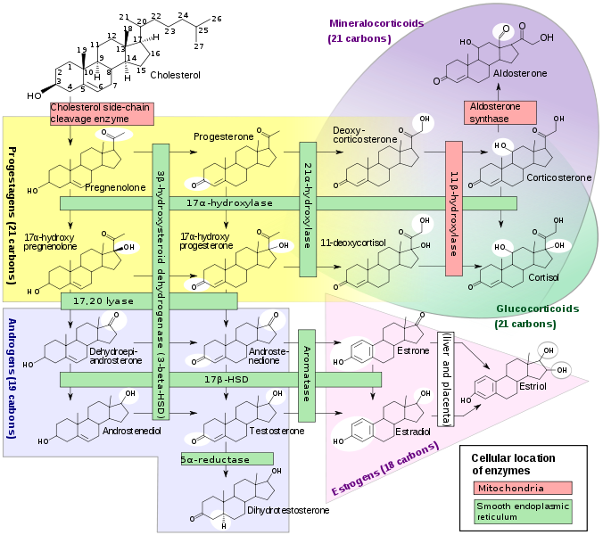

Slide 26
Adrenogenital Syndrome
Hyper-secretion:
Precocious puberty is appearance of secondary sexual characteristics in children, before the age of 8 years

Slide 27
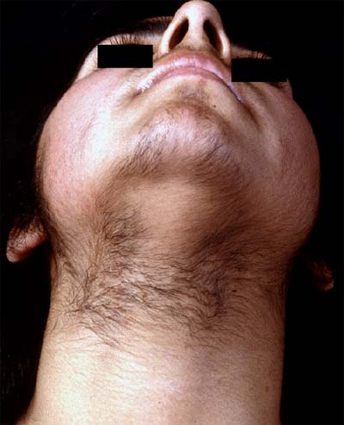
Adrenogenital Syndrome
In Adult females causes beard growth, deeper voice, masculine distribution of body hair (hirsutism), and growth of the clitoris to resemble a penis.

Slide 28
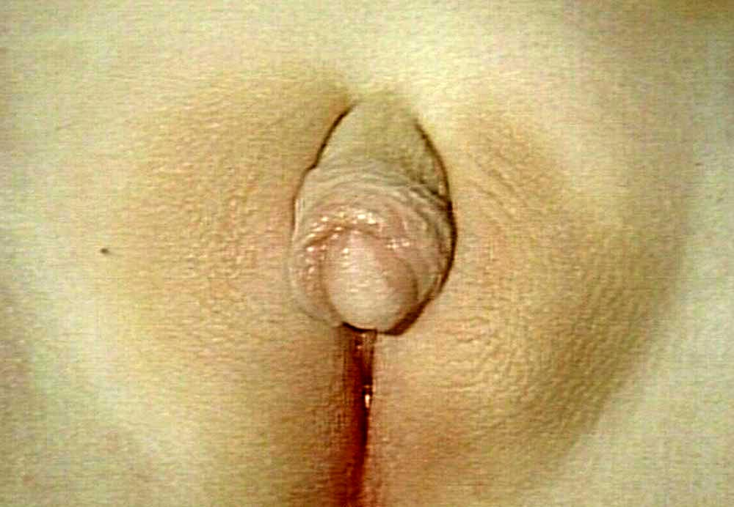
Endocrine Activity of the Adrenal Cortex
Hyper-secretion:
Picture: Virilizing adrenal hyperplasia in a newborn female baby, DHEA was converted to testosterone
Condition: Clitoromegaly

Slide 29
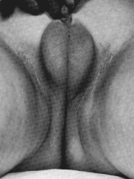
Hypopituitarism
Micropenis in a newborn baby boy.
The result of the lack of production of LH and therefore testosterone by the cells of Leydig
Normal newborn penis is 2.8 to 4.2cm
with a circumference of 0.9 to 1.3cm
Micro penis: Length less then 1.9cm

Slide 30
Other Thyroid Hormones
Parafollicular cells
Calcitonin

Slide 31
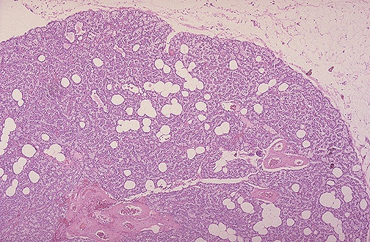
Parathyroid Hormones
Principle Cells: PTH
Five major actions:
1) Activates and increases the number of osteoclasts, which mobilizes calcium from bone
2) Increases renal tubular reabsorption of calcium
3) Increases conversion of Vitamin D to active dihyoxy form in kidneys
4) Increases urinary phosphate excretion, which reduces calcium loss
5) Increases GI calcium absorption

Slide 32
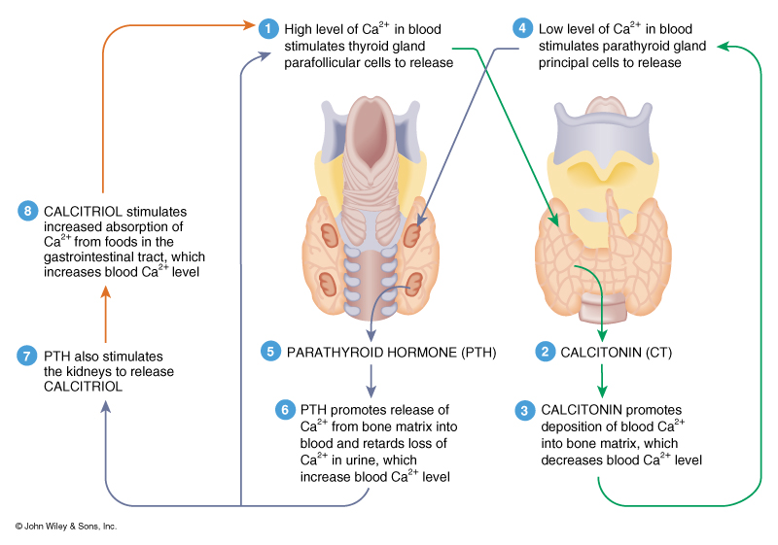
Interactions of PTH and Calcitonin

Slide 33
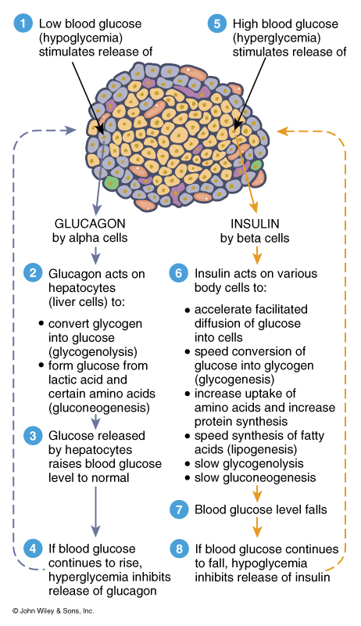
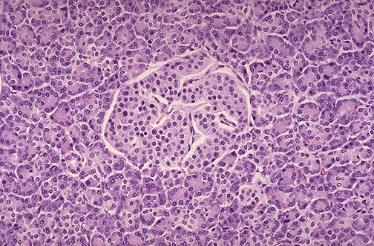
Interaction of 2 Pancreatic Hormones

